Slide 1
Reliability Settings

Slide 2
Alarm Threshold Setting

Slide 3
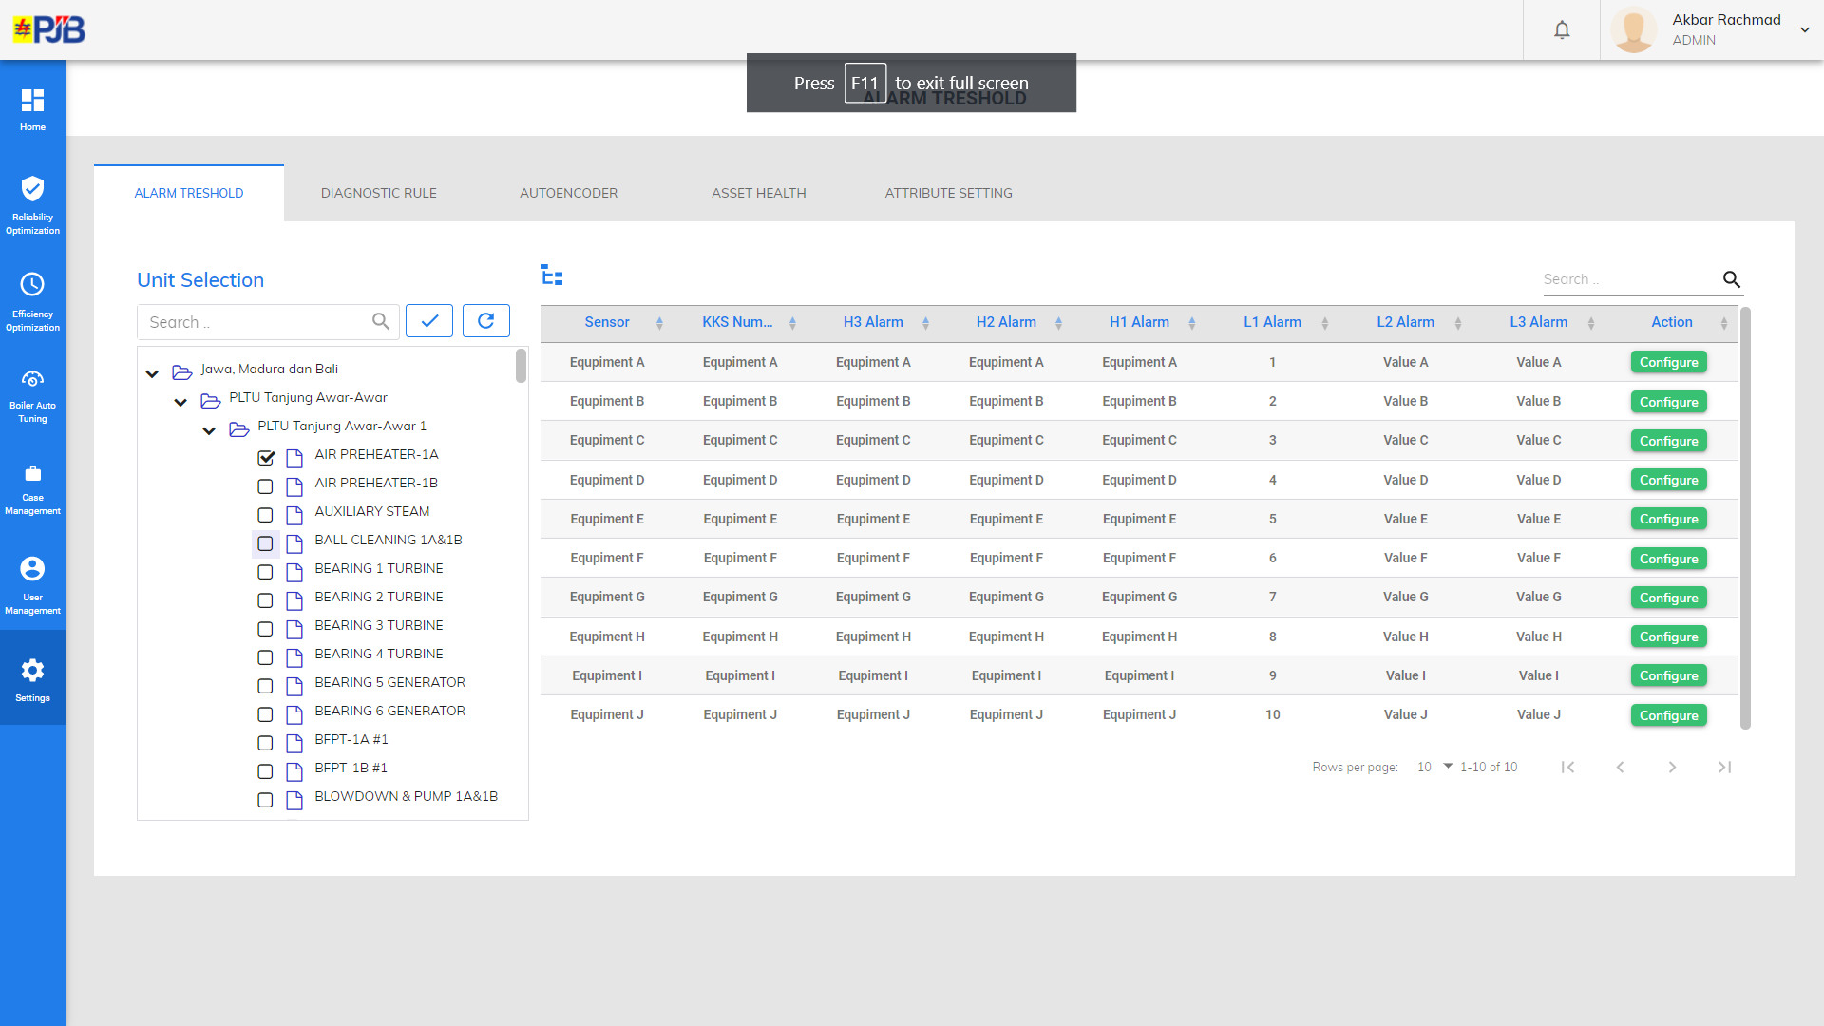

Slide 4
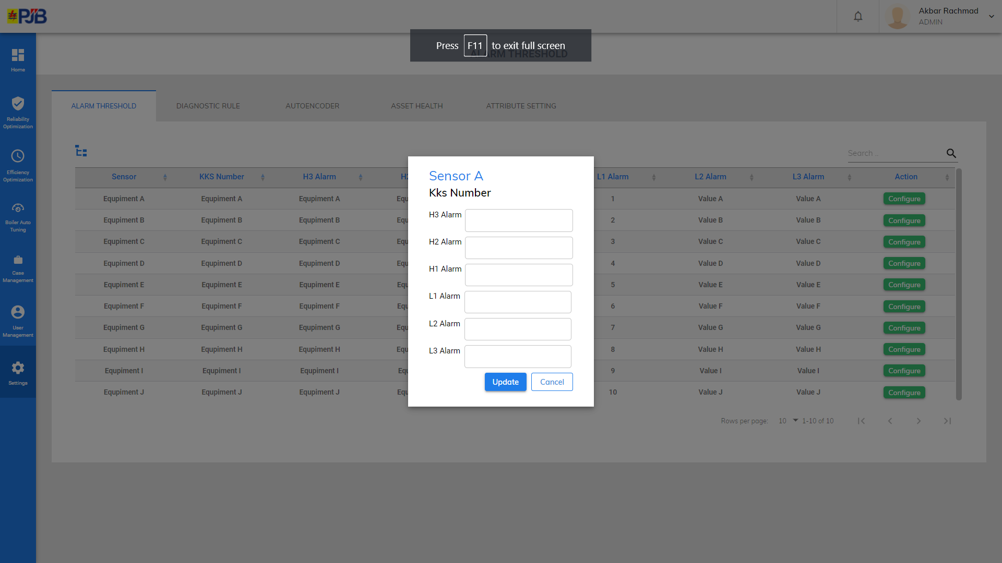

Slide 5
Diagnostic Rule Overview
Unit – Equipment : Tag KKS (Tag Description)
No | Symptom – Cause
1 | Symptom : Blablablabla
2 | Symptom : Blablablabla Cause : Blablabla
3 | Symptom : Blablablabla
4 | Symptom : Blablablabla
5 | Symptom : Blablablabla Cause : Blablabla
Pagination

Slide 6
Asset Health Setting

Slide 7
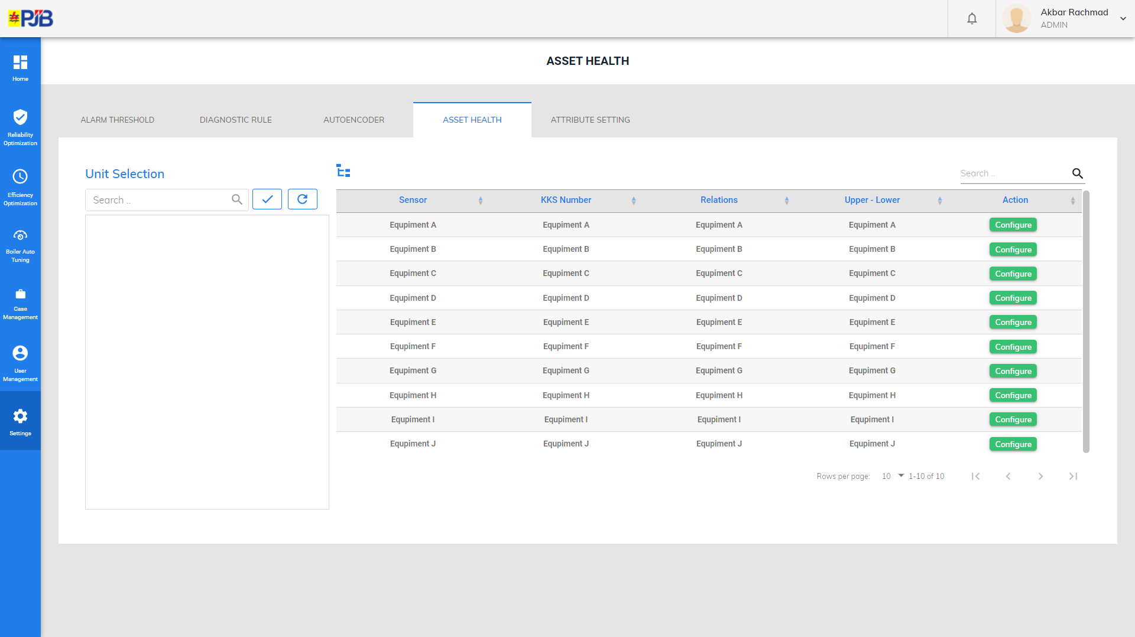

Slide 8
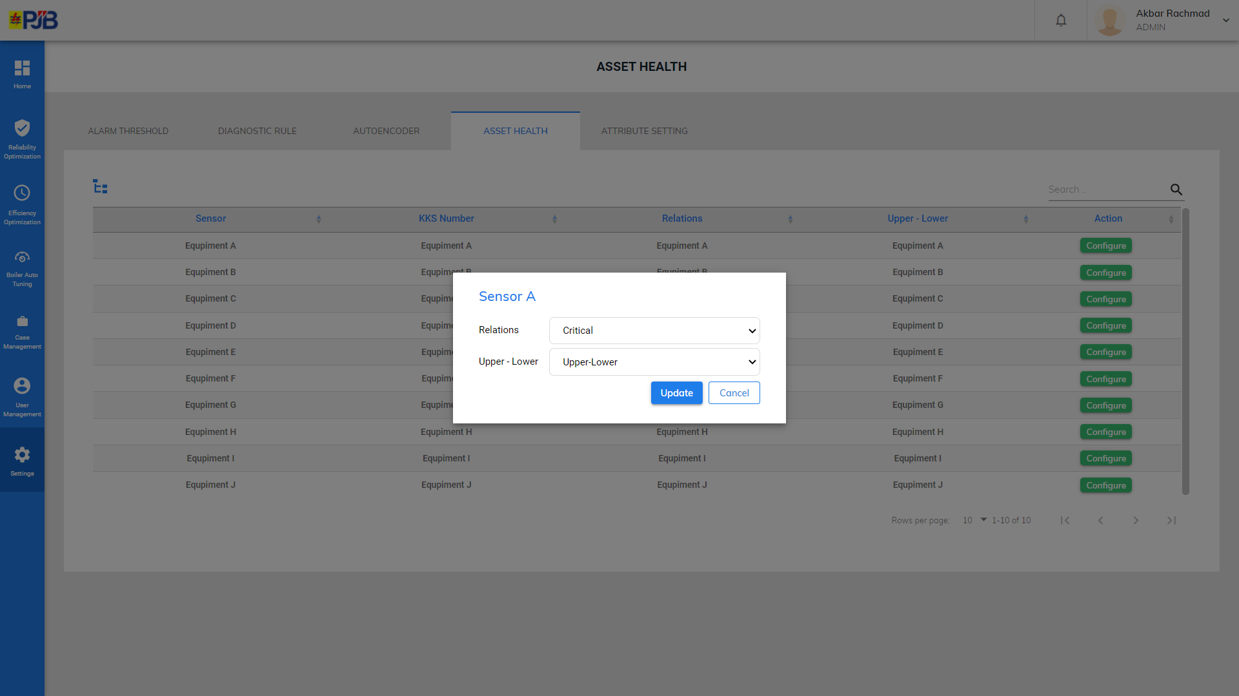

Slide 9
Autoencoder Setting

Slide 10
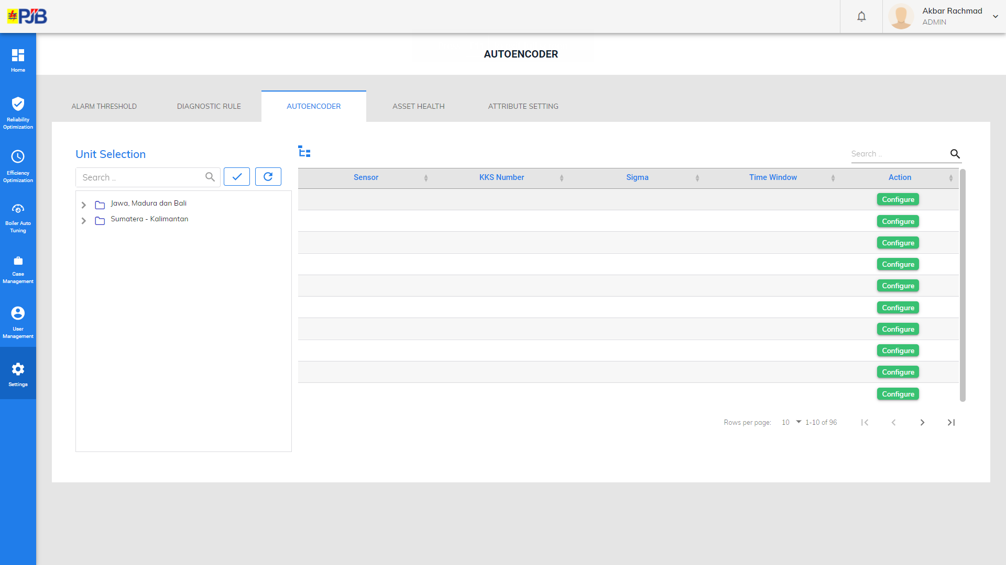

Slide 11
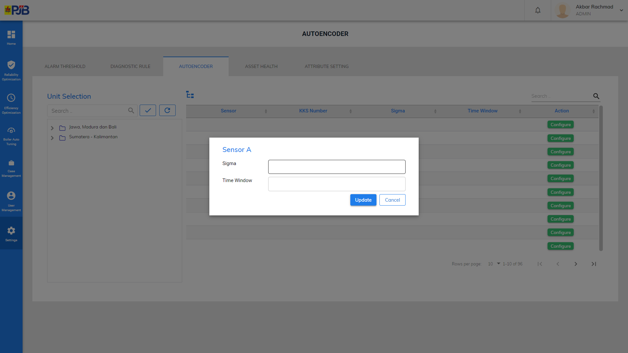

Slide 12
Cost Benefit Analysis Setting

Slide 13
Cost Benefit Analysis Settings
Alarm Threshold
Diagnostic Rule
Autoencoder
Cost Benefit Analysis
Tree View (Plant-Unit-Equipment)
Unit - Equipment
Recommendation | Prod Loss During Failure | Time To Repair | Waiting Material | Max Load During Repair | Prod Loss During Repair | Installation Time | Equipment Price | Max Load During Installation | Prod Loss During Installation | Action
 |  |  |  |  |  |  |  |  |  | Configure
 |  |  |  |  |  |  |  |  |  | Configure
 |  |  |  |  |  |  |  |  |  | Configure
Pagination

Slide 14
Cost Benefit Analysis Settings
Alarm Threshold
Diagnostic Rule
Autoencoder
Cost Benefit Analysis
Tree View (Plant-Unit-Equipment)
Unit - Equipment
Recommendation | Prod Loss During Failure | Time To Repair | Waiting Material | Max Load During Repair | Prod Loss During Repair | Installation Time | Equipment Price | Max Load During Installation | Prod Loss During Installation | Action
 |  |  |  |  |  |  |  |  |  | Configure
 |  |  |  |  |  |  |  |  |  | Configure
 |  |  |  |  |  |  |  |  |  | Configure
Unit – Equipment
Recommendation
Prod Loss During Failure :
Time To Repair :
Waiting Material :
Max Load During Repair :
Prod Loss During Repair :
Installation Time :
Equipment Price :
Max Load During Installation :
Prod Loss During Installation :
Update
Cancel
Pagination

Slide 15
CMMS Assets Setting

Slide 16
Cost Benefit Analysis Settings
Alarm Threshold
Diagnostic Rule
Autoencoder
Cost Benefit Analysis
CMMS Assets
Tree View (Plant-Unit)
Unit
Add New Asset
Equipment | Asset Number | Asset Description | Action
 |  |  | Configure
 |  |  | Configure
 |  |  | Configure
 |  |  | Configure
 |  |  | Configure
Add New Asset
Unit
Equipment : Dropdown (List Equipment)
Asset Number : (Isian)
Asset Description : (Isian)
Configure
Equipment : Equipment A
Asset Number : (Isian)
Asset Description : (Isian)
Update
Cancel
Update
Cancel
Pagination

Slide 17
Efficiency Settings

Slide 18
Efficiency Reference Setting

Slide 19
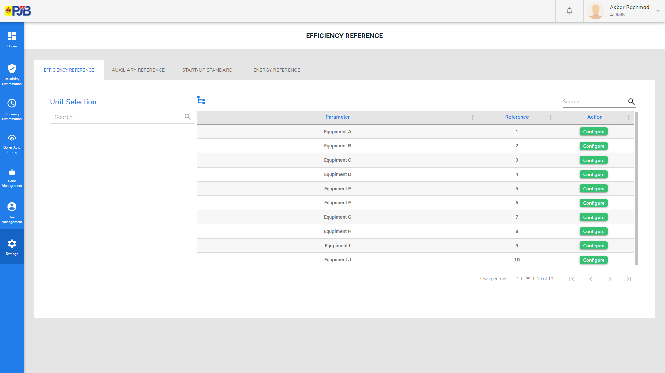

Slide 20
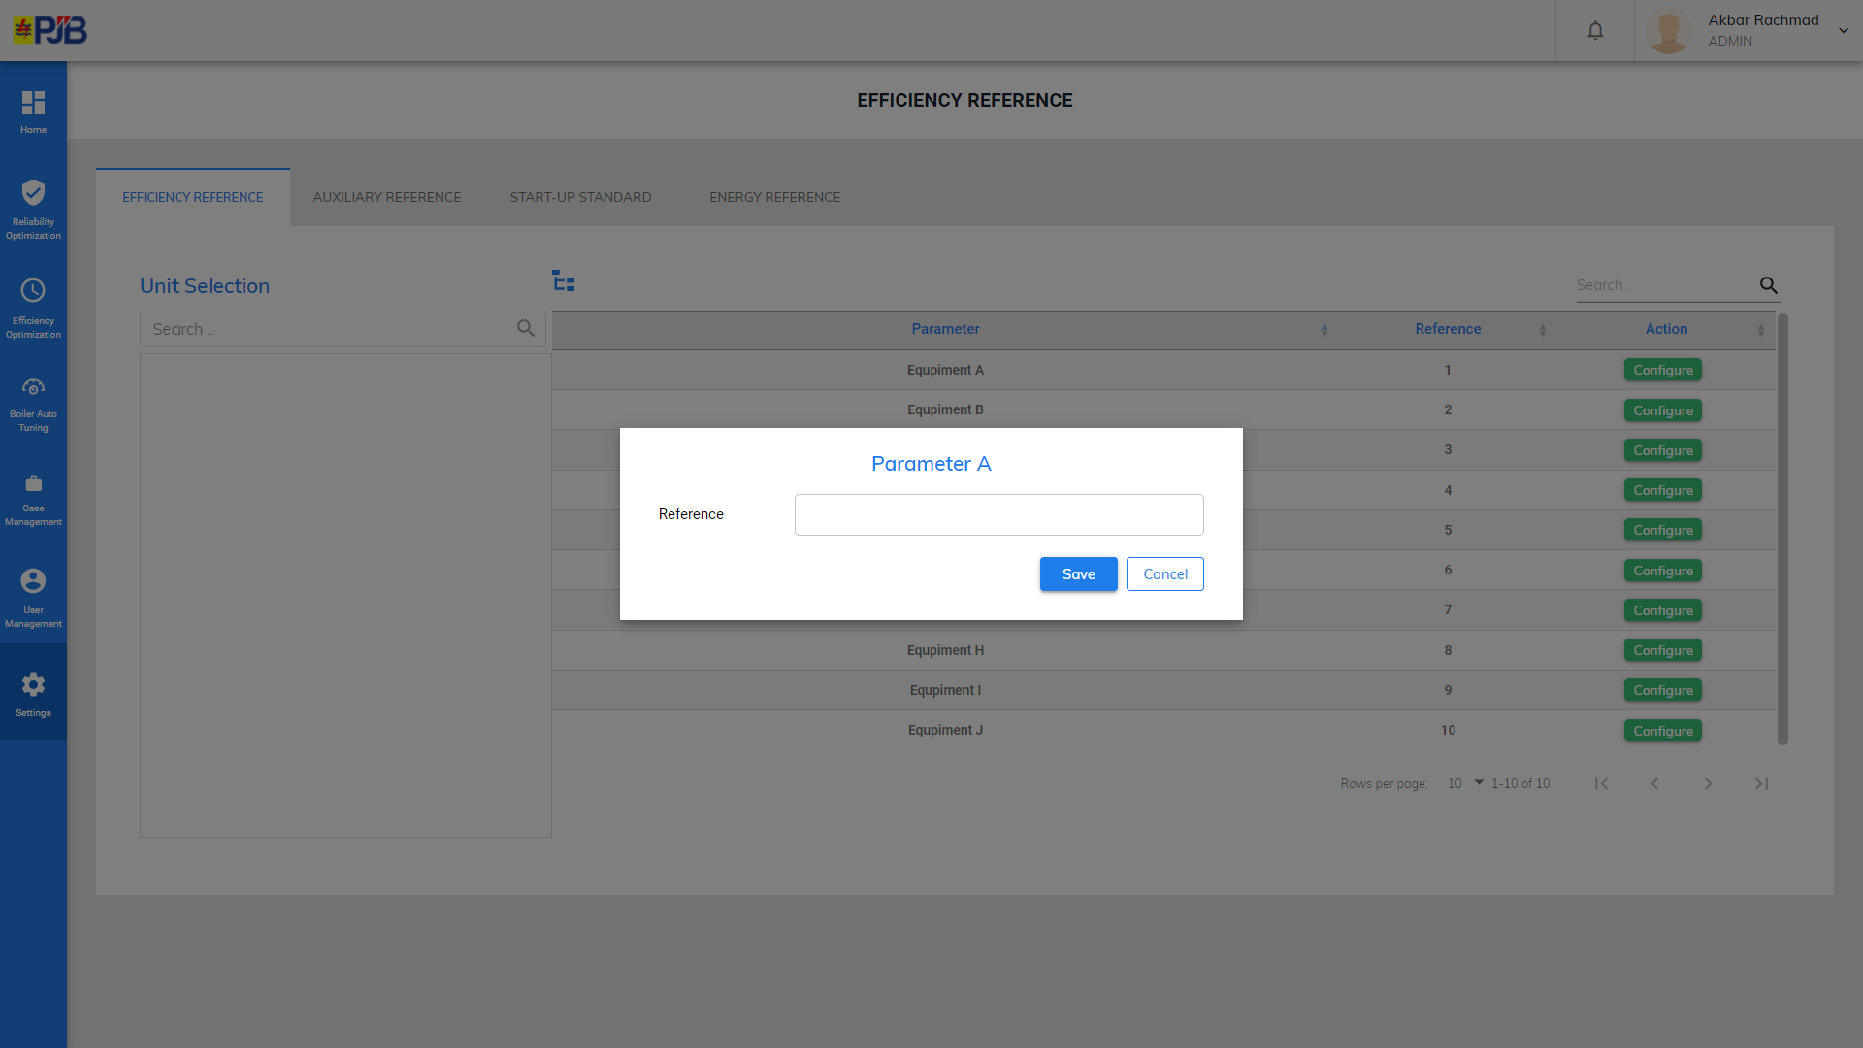

Slide 21
Start-Up Standard Setting

Slide 22
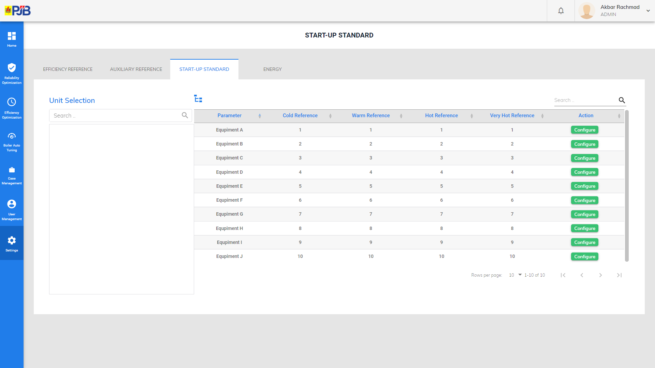

Slide 23
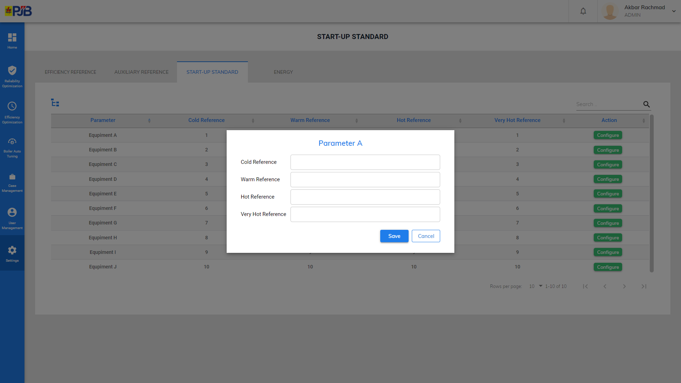

Slide 24
Auxiliary Reference Setting

Slide 25
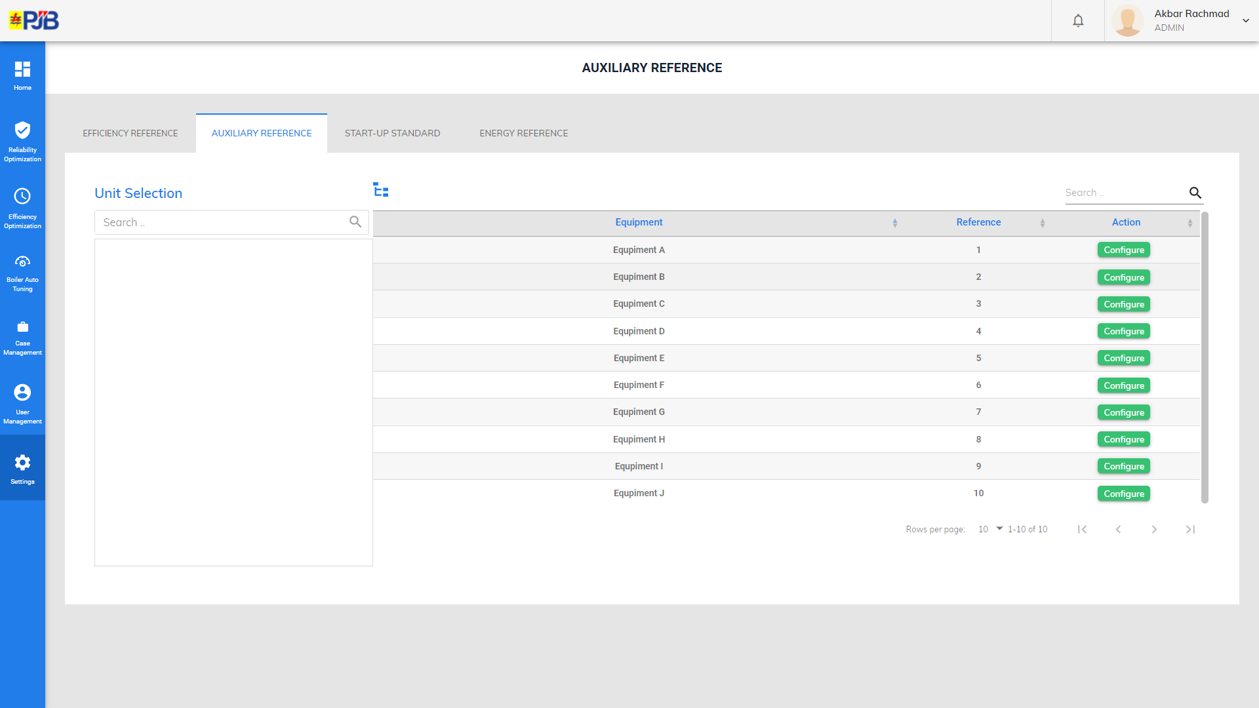

Slide 26
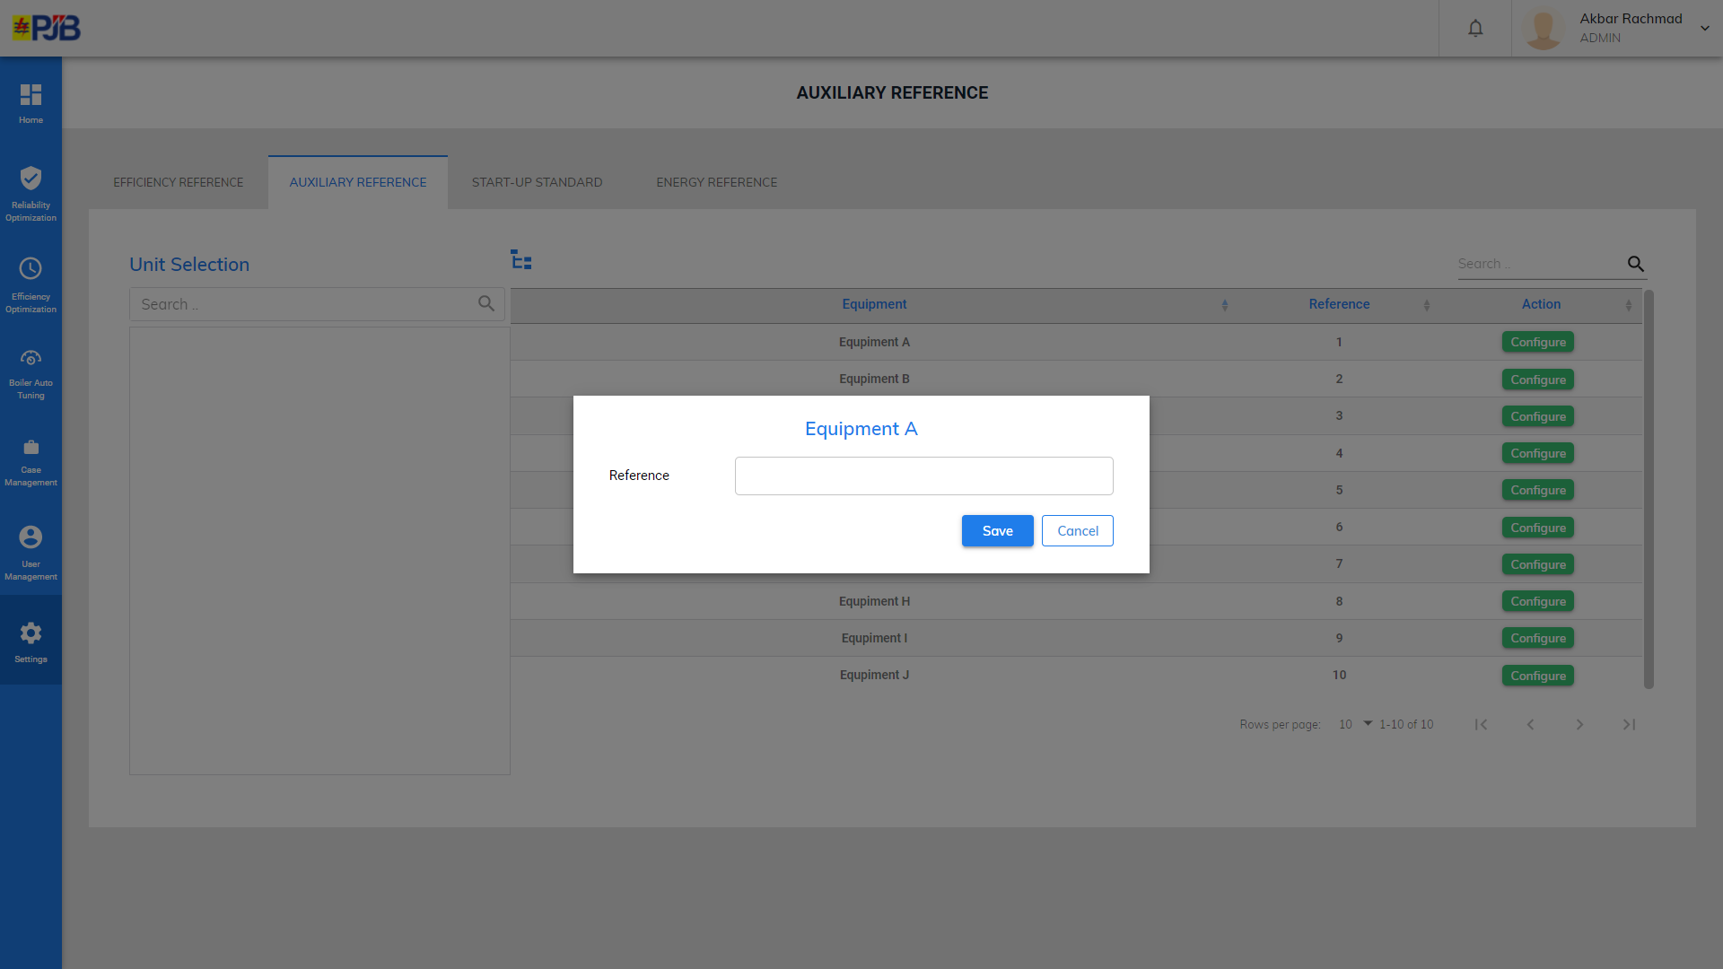

Slide 27
Energy Reference Setting

Slide 28
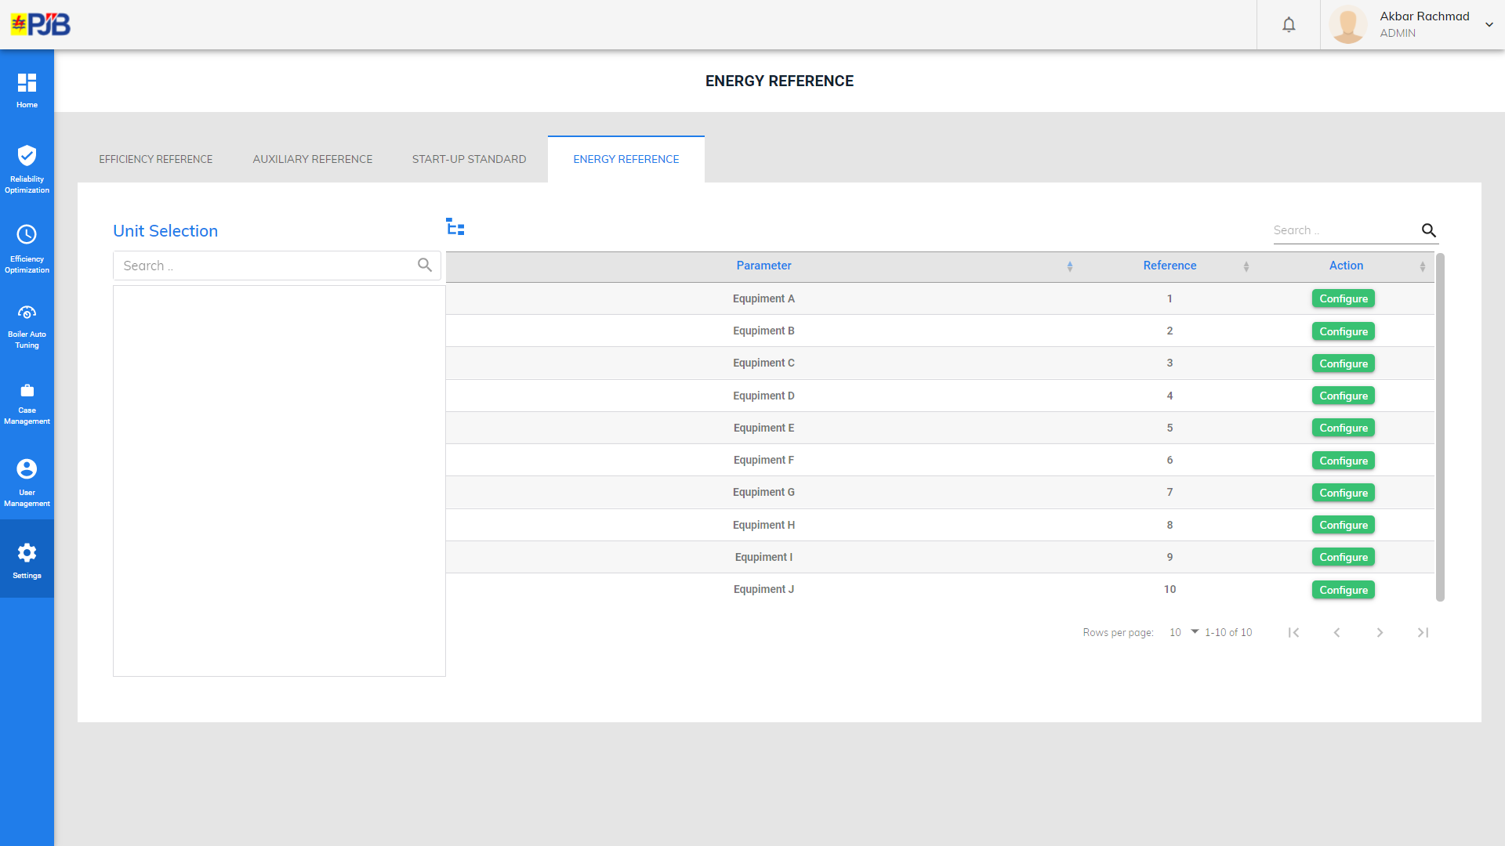

Slide 29
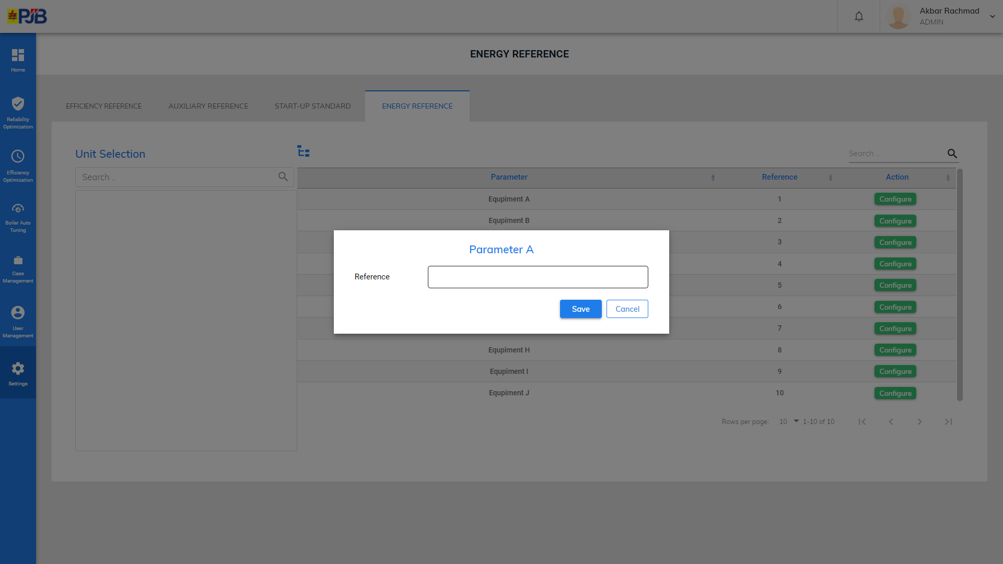

Slide 30
Unit Settings

Slide 31
Unit Settings
Unit | Capacity | Start-Up Cost | Production Cost | Unit Active | SOK Active | SOE Active | Action
 |  |  |  |  |  |  | Configure
 |  |  |  |  |  |  | Configure
 |  |  |  |  |  |  | Configure
 |  |  |  |  |  |  | Configure
 |  |  |  |  |  |  | Configure
Unit
Unit Name : (Isian)
Capacity : (Isian)
Start-Up Cost : (Isian)
Production Cost : (Isian)
Unit Active : (Dropdown)
SOK Active : (Dropdown)
SOE Active : (Dropdown)
Update
Cancel
Pagination

Slide 32
Plant Settings

Slide 33
Plant Settings
Plant | Regional | Longitude-Latitude | Address | URL Image | Plant Active | SOK Active | SOE Active | Action
 |  |  |  |  |  |  |  | Configure
 |  |  |  |  |  |  |  | Configure
 |  |  |  |  |  |  |  | Configure
 |  |  |  |  |  |  |  | Configure
 |  |  |  |  |  |  |  | Configure
Plant
Plant Name : (Isian)
Regional : (Dropdown)
Longitude-Latitude : (Isian)
Address : (Isian)
URL Image : (Upload Gambar)
Plant Active : (Dropdown)
SOK Active : (Dropdown)
SOE Active : (Dropdown)
Update
Cancel
Pagination

